Slide 1

CREDIT CARD APPROVAL PREDICTION
Name of the Student: Vajrala SubbaReddy
Register Number: 39111051
Project Supervisor: Ms.V.GowrManohari

Slide 2
Presentation Outline
Introduction
Objectives
System Architecture
Module Implementation
Application Snapshots
Results and Discussions
Conclusion
References

Slide 3

Introduction
Banks receive a lot of applications for issuance of credit cards. Many of them are rejected for many reasons, like high-loan balances, low-income levels, or too many inquiries on an individual’s credit report. Manually analyzing these applications is error-prone and a time-consuming process. Luckily, this task can be automated with the power of machine learning and pretty much every bank does so nowadays. In this project, we will build an automatic credit card approval predictor using machine learning techniques, just like the real banks do.
In this project, we will be using regression algorithms such as Decision tree, Random forest, KNN, and xgboost. We will train and test the data with these algorithms. From this the best model is selected and saved in pkl format. We will be doing flask integration and IBM deployment.

Slide 4

Objective
Project Objectives:
By the end of this project you will:
Know fundamental concepts and techniques used for machine learning.
Gain a broad understanding about data.
Have knowledge on pre-processing the data/capping techniques on outlier and some visualization concepts.
Gain some ideas on algorithm selection

Slide 5
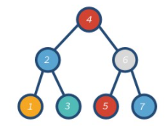
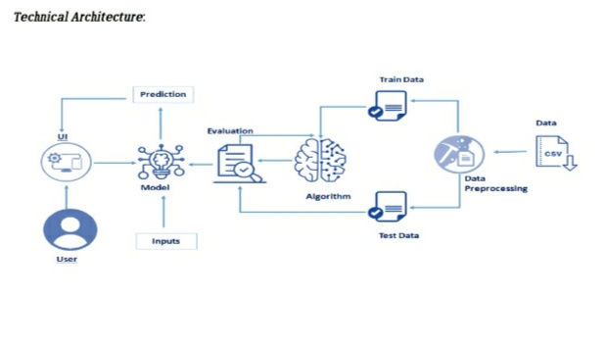
System Architecture

Slide 6

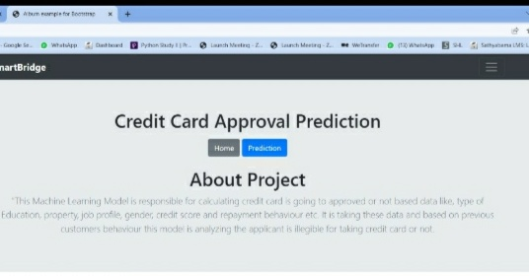
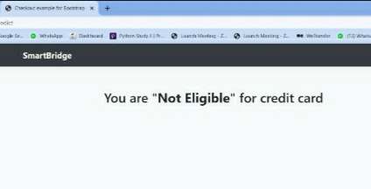
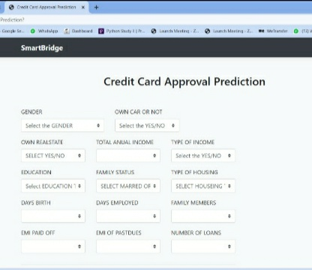
Project Design

Slide 7
Modules
Modules | Description
flask | Flask is a web framework, it's a Python module that lets you develop web applications easily.
random | The random module is a built-in module to generate the pseudo-random variables.
Regression | A machine leaning technique where the model predicts the output as a continuous numerical value
Xgboost | Extreme gradient ,is a scalable ,distributed gradient-boosted decision tree machine learning library .It provides parallel tree boosting and is the leading machine learning library for regression ,classification ,and ranking problems
Decision Tree | Where the data is continuously split according to a certain parameter. The tree can be explained by two entities ,namely decision nodes and leaves

Slide 8
Hardware and Software Requirements
Hardware:
Software:
1.Anaconda software
2.jupyter
3.Chrome
CPU: 2 x 64-bit 2.8 GHz 8.00 GT/s CPUs.
RAM: 32 GB (or 16 GB of 1600 MHz DDR3 RAM)
Storage: 300 GB. ...

Slide 9

Methodology
Step 1. First ask User to run the flask module
Step 2. Go for prediction option
Step 3. Enter your personal details.
Step 4. After entering your details you can check whether you are eligible for credit card or not

Slide 10

Results and Discussion
Credit evaluation and approval is the process a business or an individual must go through to become eligible for a loan or to pay for goods and services over an extended period. It also refers to the process businesses or lenders undertake when evaluating a request for credit. Granting credit approval depends on the willingness of the creditor to lend money in the current economy and that same lender's assessment of the ability and willingness of the borrower to return the money or pay for the goods obtained-;plus interest-;in a timely fashion. Typically, small businesses must seek credit approval to obtain funds from lenders, investors, and vendors, and also grant credit approval to their customers

Slide 11

Conclusion
On completion of our project after our results we reach to the conclusion that uses can predict their credit card status whether they are eligible or not for the credit card approval by entering their personal details like income, age ,loans ,housing status ,education qualifications ,gender ,they own a car or not...ect

Slide 12
References
REFERENCES:
Google
https://www.google.com/
Bootstrap
https://getbootstrap.com/
smartintern
https://smartinternz.com/
Kaggle
https://www.kaggle.com/

